Slide 1
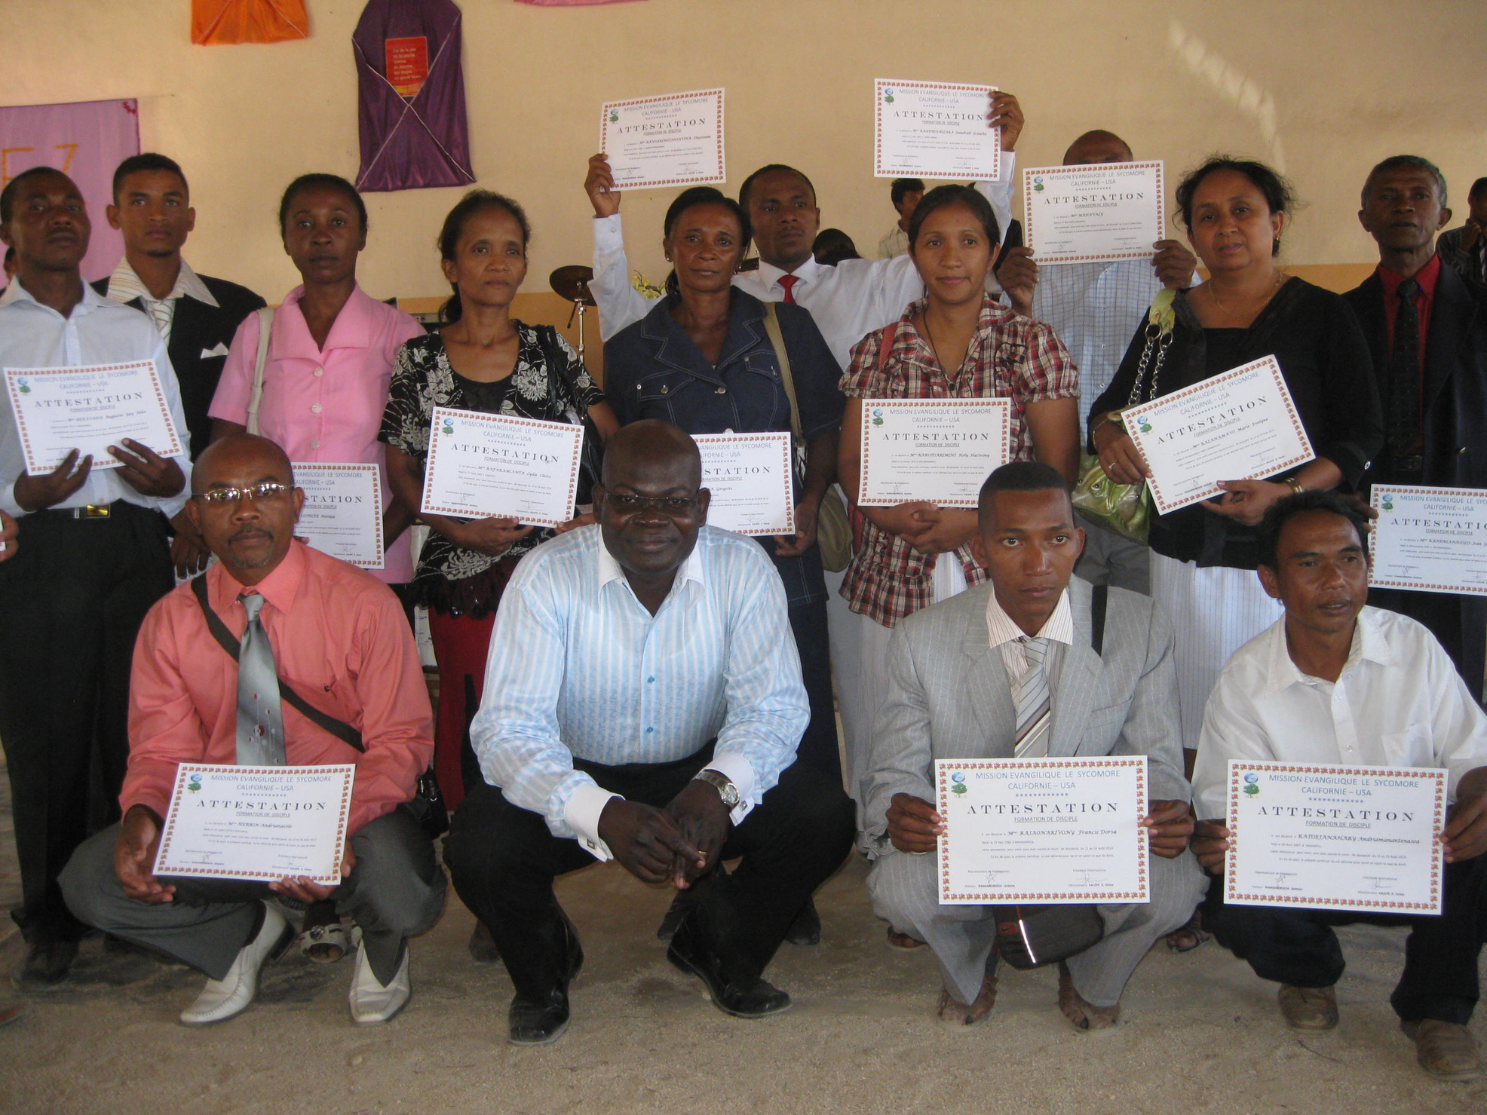
SYCOMORE EVANGELICAL MISSION
EQUIPPING LEADERS FOR THE HARVEST OF SOULS

Slide 2
WHO WE ARE
S.E.M. is a non-denominational mission organizations. We work with Protestant, Evangelical, Pentecostal churches and Christian associations. We work for the development and advancement of missionary work in Madagascar, Togo, Gabon, Congo RDC, USA and subsequently around the world

Slide 3
OUR PLEDGE
TO GO AND TO MAKE HIM KNOWN
Our Vision
Our Mission
Our Goals
Our vision is to reach the unreached for Jesus Christ in Madagascar, Togo, Gabon and subsequently around the world, just as the Sycamore tree enabled Zacchaeus to come in contact with our Lord Jesus Christ for his eternal salvation. (Luke 19:4-5)
- EVANGELISM
- MOBILIZATION
-TRAINING- SMII
- SENDING
Make disciples of all Nations so that from every nation, from all tribes and peoples and languages, a great multitude will be standing before the throne of God on the last day.
JOHN4:34 & MATTHEW9:37-38

Slide 4
Key Activities
TRAINING
SYCOMORE MISSION
INTERNATIONAL
INSTITUTE
EQUIPPING LOCALS TO REACH THEIR OWN
EVANGELISM
THROUGH THE JESUS FILM PROJECTION IN THEIR LOCAL LANGUAGES
OUR MISSION FIELDS
MOBILIZATION
AWAKEN THE BELIEVERS CONCERNING THE LORD’S HARVEST
HARVEST THROUGH MISSION CONFERENCE
MADAGASCAR, CONGO RDC
GABON, TOGO, SENEGAL, CONGO,
IVORY COAST AND CHAD

Slide 5
OUR HISTORY
2008
2012
2013 - PRESENT
EXTENDED TO
CALIFORNIA- USA
ESTABLISHED
IN GEORGIA- USA
STARTED IN LOME,
TOGO - WEST AFRICA
2014
2018
2020
EXPLOIT - MISSION CONFERENCE
LAST SATURDAY PRAYER FOR THE NATIONS
SYCOMORE
MISSION INTERNATIONAL INSTITUTE

Slide 6
OUR JERUSELEM & JUDEA
LAST SATURDAY PRAYER FOR THE NATIONS
EXPLOIT - MISSION CONFERENCE
SYCOMORE MISSION INTERNATIONAL INSTITUTE
MENTORING

Slide 7
OUR SAMARIA AND THE ENDS OF THE EARTH
LAST SATURDAY PRAYER FOR THE NATIONS IN FRENCH
EXPLOIT - MISSION CONFERENCE IN FRENCH
SYCOMORE MISSION INTERNATIONAL INSTITUTE IN FRENCH
EVANGELISM AND CHURCH PLANTING

Slide 8
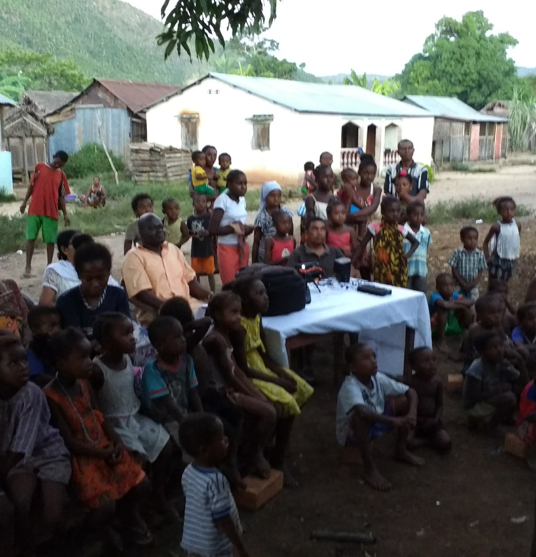
MADAGASCAR
OUR MISSION BASE
JESUS FILM BACKPACK
Evangelism in done in their local languages so that they can better understand the message of Jesus and act on it.
CHURCH PLANTING
Local leaders are trained to lead the churches planted effectively in making them disciples of Jesus.
SOCIAL WORK
Financial help to build or repair churches and so on.

Slide 9
MADAGASCAR

Slide 10
MADAGASCAR

Slide 11
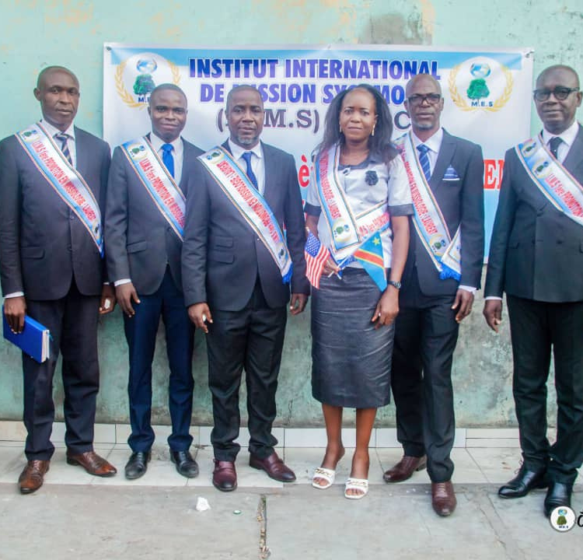
CONGO, RDC
OUR MISSION FIELD
JESUS FILM BACKPACK
Evangelism in done in their local languages so that they can better understand the message of Jesus and act on it.
TRAINING
Pastors and leaders are train in missiology in order to impact their congregation so that they can go and make disciples of all Nations.

Slide 12
CONGO, RDC

Slide 13
CONGO, RDC

Slide 14
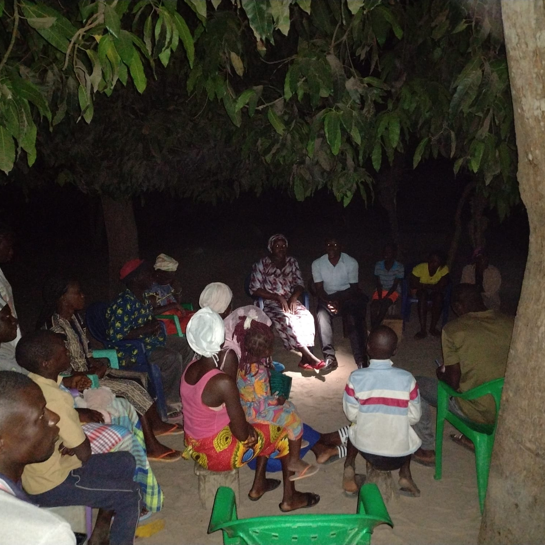
SENEGAL
OUR MISSION FIELD
JESUS FILM BACKPACK
Evangelism in done in their local languages so that they can better understand the message of Jesus and act on it.
CHURCH PLANTING
Local leaders are trained to lead the churches planted effectively in making them disciples of Jesus.

Slide 15
SENEGAL

Slide 16
SENEGAL

Slide 17
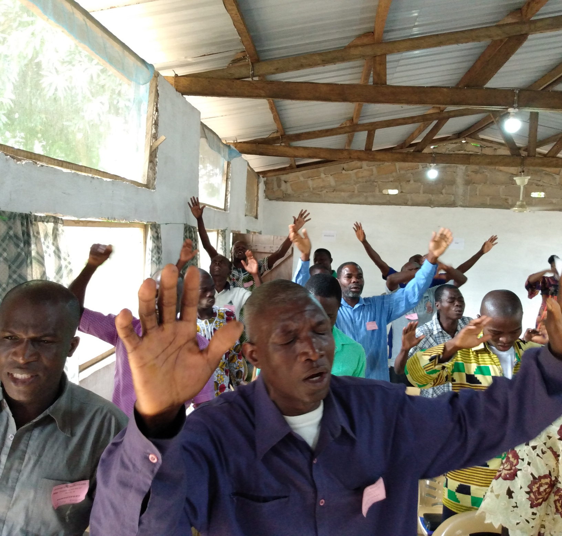
TOGO
OUR MISSION FIELD
JESUS FILM BACKPACK
Evangelism in done in their local languages so that they can better understand the message of Jesus and act on it.
CHURCH PLANTING
Local leaders are trained to lead the churches planted effectively in making them disciples of Jesus.

Slide 18
TOGO

Slide 19
TOGO

Slide 20
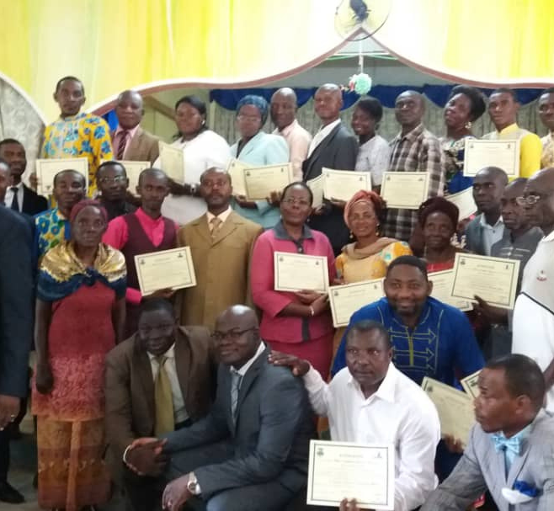
GABON
OUR MISSION FIELD
JESUS FILM BACKPACK
Evangelism in done in their local languages so that they can better understand the message of Jesus and act on it.
TRAINING
Pastors and leaders are train in missiology in order to impact their congregation so that they can go and make disciples of all Nations.

Slide 21
GABON

Slide 22
GABON

Slide 23
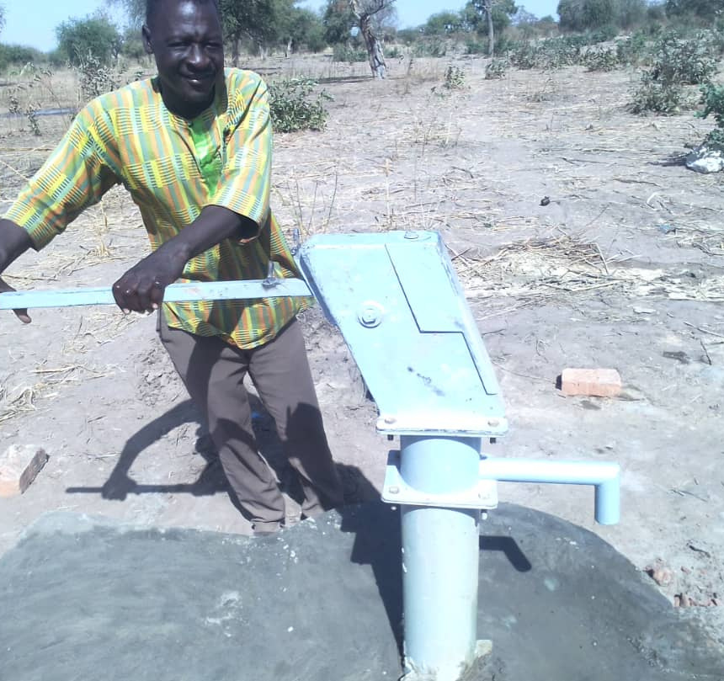
CHAD
OUR MISSION FIELD
JESUS FILM BACKPACK
Evangelism in done in their local languages so that they can better understand the message of Jesus and act on it.
. TRAINING
Pastors and leaders are train in missiology in order to impact their congregation so that they can go and make disciples of all Nations.
SOCIAL WORK
Financial help to dig a well in koudou Alwa.

Slide 24
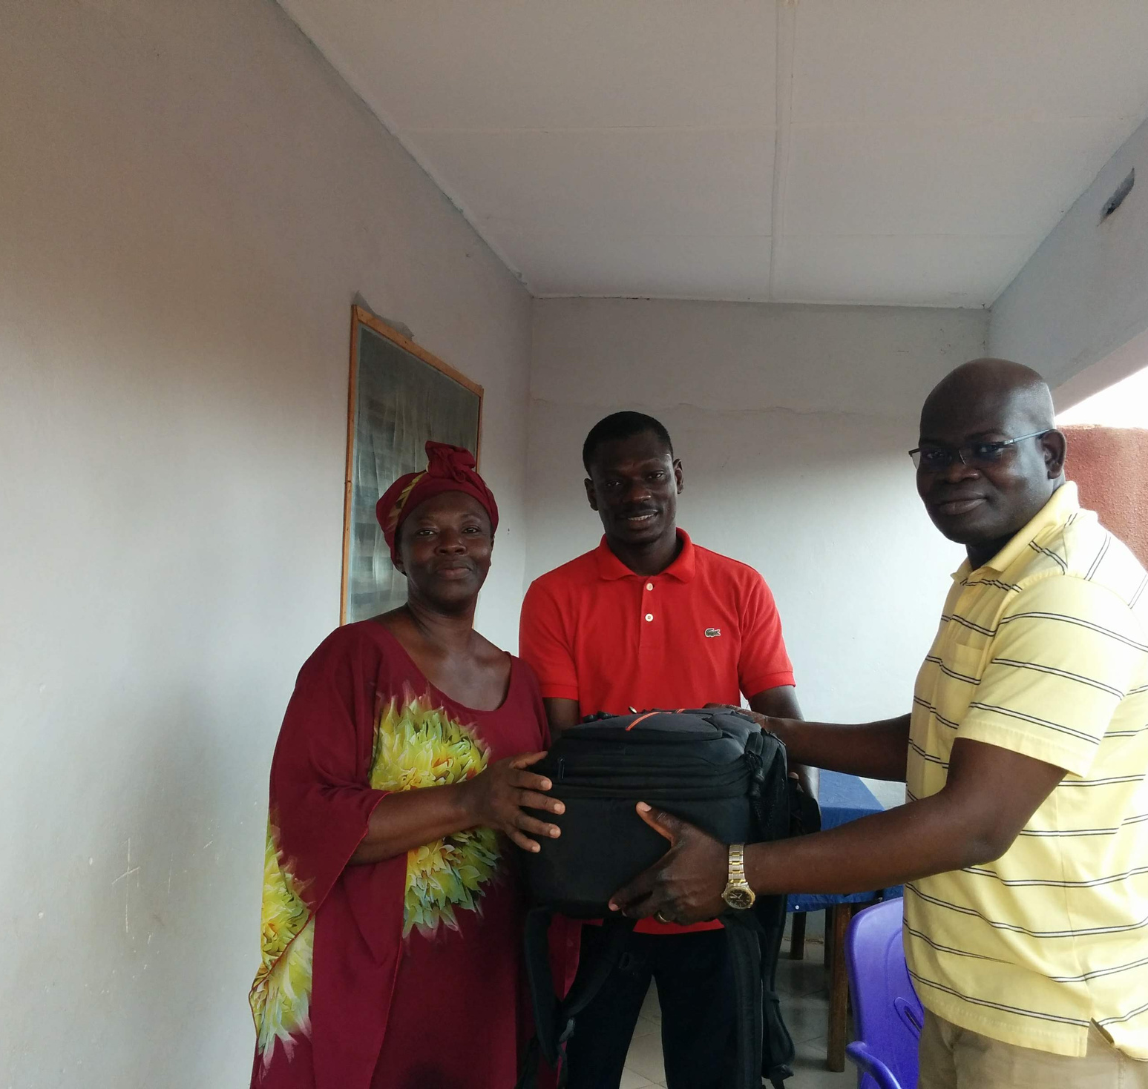
IVORY COAST
FUTURE MISSION FIELD
JESUS FILM BACKPACK
Evangelism in done in their local languages so that they can better understand the message of Jesus and act on it.
TRAINING
Pastors and leaders a train in missiology in order to impact their congregation to go and make disciples of all Nations.

Slide 25
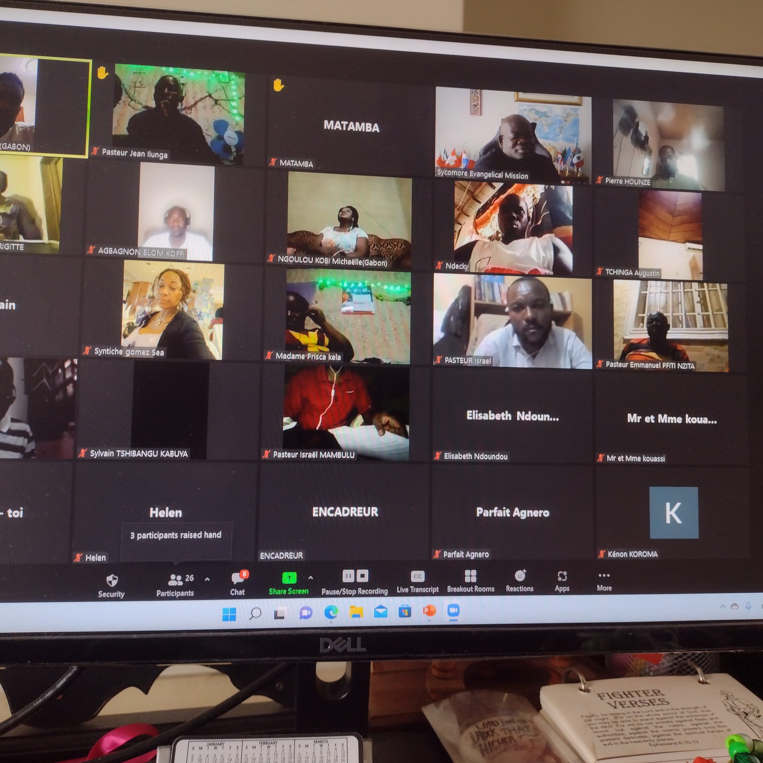
CONGO BRAZZAVILLE
FUTURE MISSION FIELD
TRAINING
Pastors and leaders are train in missiology in order to impact their congregation so that they can go and make disciples of all Nations.

Slide 26
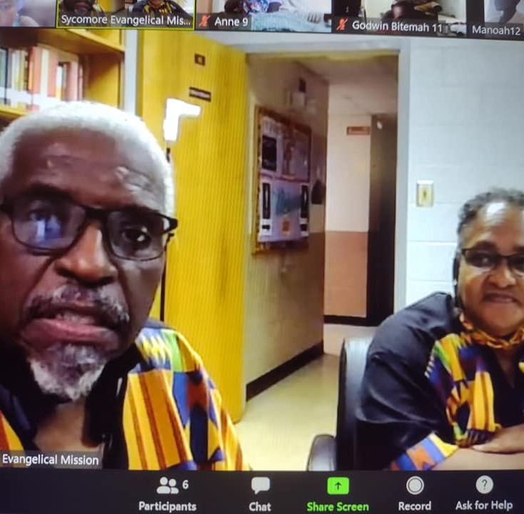
USA
THE AFRICAN AMERICAN CHRUCH
MOBILIZATION
Through our annual mission conference and our monthly prayer for the nations.
TRAINING
Leaders and individual are train in missiology in order to impact their congregation to go and make disciples of all Nations.

Slide 27
USA

Slide 28
USA

Slide 29
FUTURE PLANS
Getting more Africans and African American Church leaders to be mobilized and trained in mission so that they can reach the lost effectively in a cross-cultural settings.
Evangelism and church planting in more African countries in order to make disciples of Jesus Christ.

Slide 30
CONTACT
THANK YOU
sycomoreevangelicalmission@gmail.com
404-647-1723 / 909-648-9971
WWW.SYCOMOREMONDE.ORG
Sycomore Evangelical Mission
We look forward to PARTNERING with you.
Sycomore mission

